Slide 1
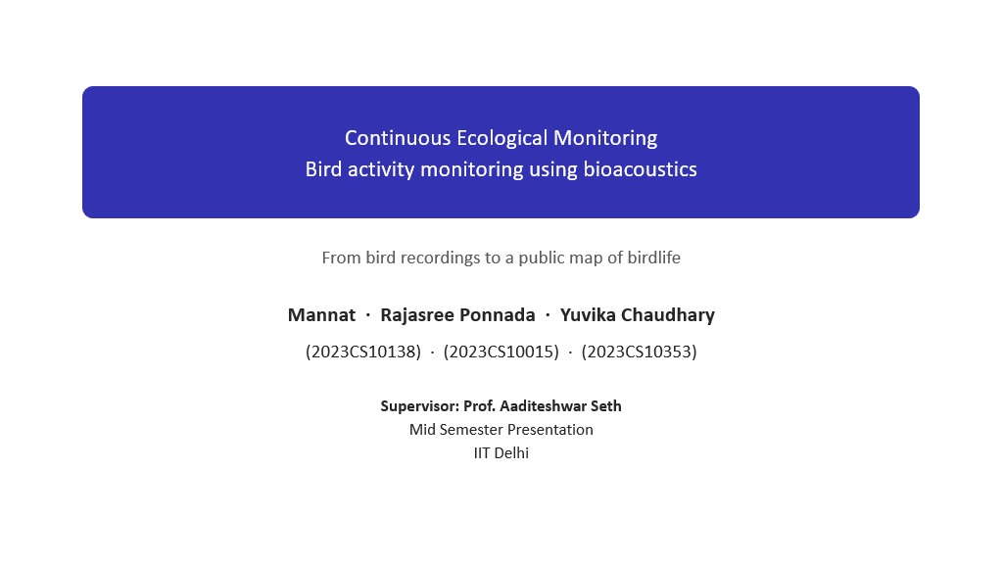
Continuous Ecological Monitoring
Methodology: from field audio to bird-activity metrics
How recordings become reliable detections, and detections become ecology

Slide 2
Contents
1
The pipeline at a glance
2
Study design
3
Pre-processing
4
Detection: BirdNET
5
Filtering
6
Acoustic indices
7
Activity Regularity and Habitat Affinity
8
Migratory classification
9
Solar alignment
10
Limitations

Slide 3
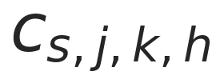
The pipeline at a glance
Five stages. This strip reappears on every slide with the current stage filled in.
1
2
3
4
5
Record
Pre-process
Detect
Filter
Analyse
Song Meter 2 at four stratified sites, 2 min on / 4 min off.
Segment, denoise, and flag rain before anything is detected.
BirdNET names the species in every 3-second window.
Five reliability steps turn raw detections into two clean datasets.
Acoustic indices, activity regularity, habitat affinity, migration, solar alignment.
Notation used throughout
s
a bird species
j
a recording location (site)
k ∈ D = {1, …, n}
a day in the study period
h ∈ H = {1, …, 24}
an hour of the day
the number of detections of species s at site j on day k during hour h. Every metric that follows is a sum or a correlation over this one quantity.

Slide 4
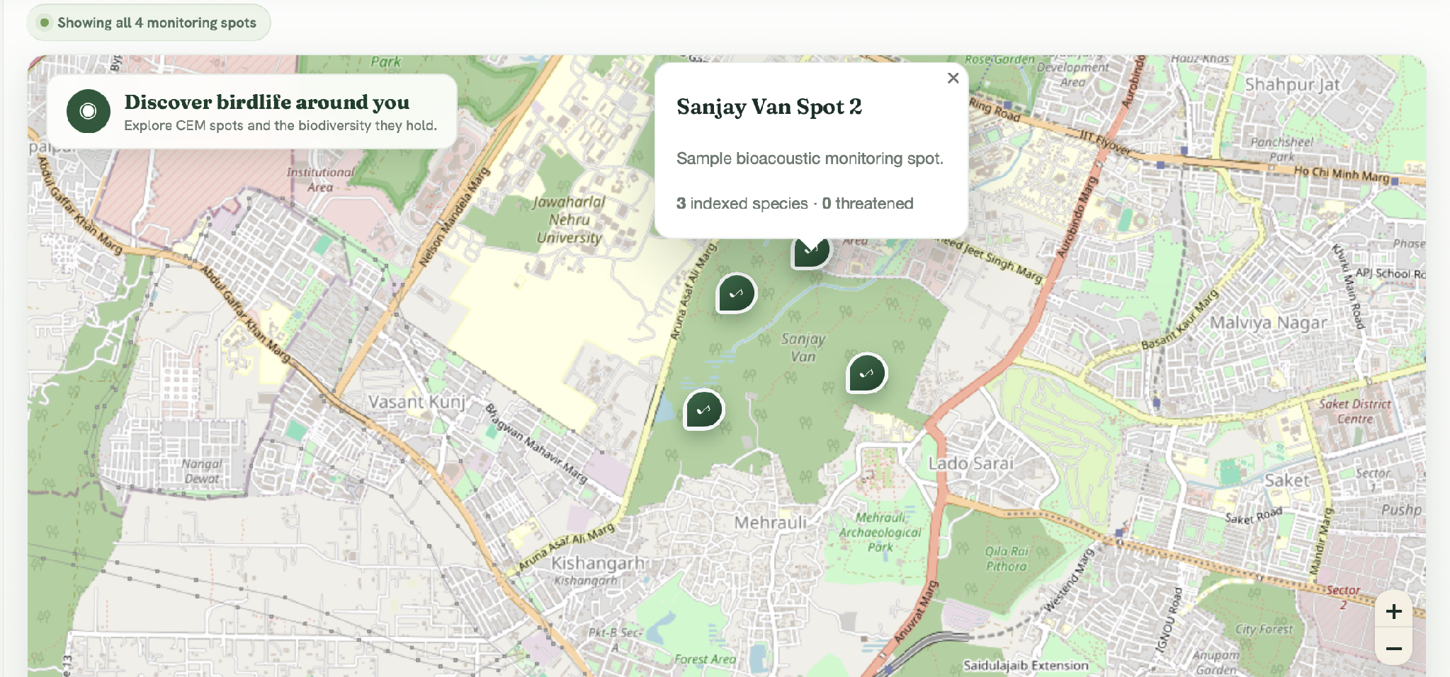
Study design
1 Record
2 Pre-process
3 Detect
4 Filter
5 Analyse
Four stratified sites
Sites chosen to differ in vegetation composition, canopy structure and habitat, so comparisons across sites mean something.
Song Meter 2 recorders
Placed to maximise ambient sound capture and minimise anthropogenic noise.
Sanjay Van, Delhi NCR: four stratified monitoring sites
2:4 duty cycle
2 minutes recording, 4 minutes sleep. Chosen from a pilot across sites: no measurable loss in species detection or index reliability, and longer field life.
Full equipment specifications, recording parameters and placement details are in the paper's appendix.

Slide 5
Pre-processing
1 Record
2 Pre-process
3 Detect
4 Filter
5 Analyse
Three steps clean the audio before any species is named.
1
Segmentation
2
Noise reduction
3
Rainfall removal
Each 2-minute file is one segment.
SNR-scaled noise subtraction in the time domain plus spectral gating in the frequency domain, applied through a short-time Fourier transform.
Heavy rain is broadband noise that inflates the Acoustic Diversity Index. A Random Forest on 40 MFCCs per 10-second chunk labels rain as None / Low / Medium / High; High segments are dropped before indices are computed.
94.17% overall accuracy
3,012 chunks from 251 files · 20% held-out test · Heavy class F1 = 0.96
Why it matters: without the rain filter, ADI produced false-positive biodiversity signals during the monsoon; with it, index values across the dataset were corrected.

Slide 6
Detection: BirdNET
1 Record
2 Pre-process
3 Detect
4 Filter
5 Analyse
What BirdNET does
What a detection is
• An open-source classifier from Cornell and Chemnitz, trained on more than 6,000 species.
• Slides a 3-second window over each segment and returns, per window, a species and a confidence in [0, 1].
• Published weights are used unchanged; nothing is trained here.
• Every detection becomes one row in the project's aggregate.csv: species, confidence, file, site, date, hour.
reads as how many times species s was heard at site j during hour h of day k. Everything downstream is built from this count.
Why confidence is a generation parameter
The confidence floor is set when BirdNET runs. A window below it is never written, so lowering the threshold later cannot recover it. Each site's effective floor is the maximum across its files, and it is recorded in the job log.

Slide 7
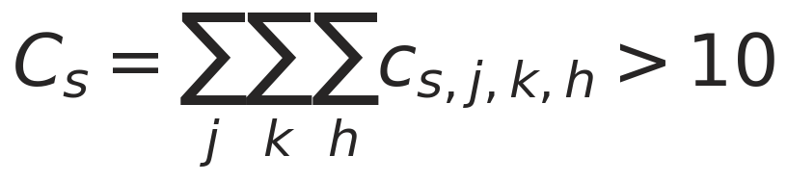
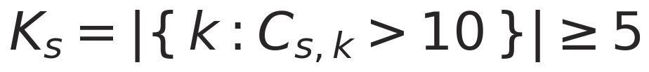
Filtering: five steps to a reliable table
1 Record
2 Pre-process
3 Detect
4 Filter
5 Analyse
1
Taxonomic verification
Two datasets
keep only species on the regional eBird / Merlin checklist
Quality-filtered
steps 1–3. The default for every analysis.
Temporally filtered
steps 1–4. Used where day-to-day structure matters: migration and solar alignment.
Where each is used
indices, regularity, affinity → quality-filtered
migration, solar → temporally filtered
2
Confidence threshold
drop low-confidence windows
3
Minimum activity
a species needs enough detections overall
4
Temporal consistency
and enough days with substantial activity
5
Rainfall removal
see Pre-processing
heavy-rain segments excluded before index computation
C_s,k is the daily total for species s, summed over sites and hours.

Slide 8
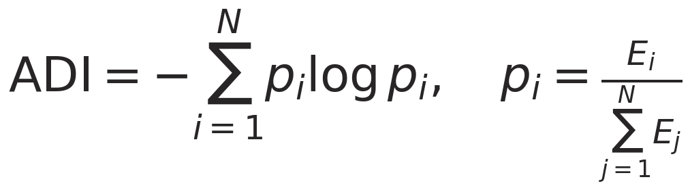
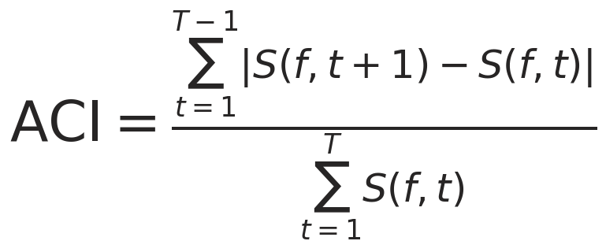
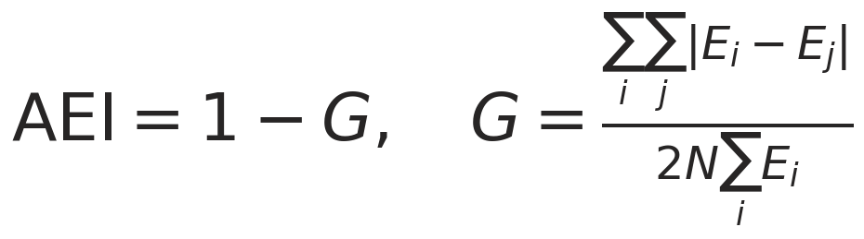
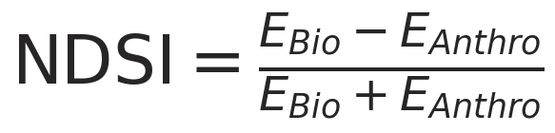
Acoustic indices: the soundscape without species
1 Record
2 Pre-process
3 Detect
4 Filter
5 Analyse
ADI
Acoustic Diversity Index
ACI
Acoustic Complexity Index
Shannon entropy of energy across N frequency bands. Higher = energy spread evenly, typical of many vocalising species.
Frame-to-frame change in amplitude, averaged over bins. High = rapid modulation, like birdsong; low = steady noise.
AEI
Acoustic Evenness Index
NDSI
Normalized Difference Soundscape Index
Complement of the Gini coefficient of band energy. Penalises one band dominating.
Biophony (2–11 kHz) against anthrophony (1–2 kHz). −1 all traffic, +1 all birds and insects.
Urban masking. At Sites 2 and 3 a high AEI did not mean a balanced soundscape but white-noise saturation from distant traffic. NDSI is what penalises that; no single index is read alone.

Slide 9
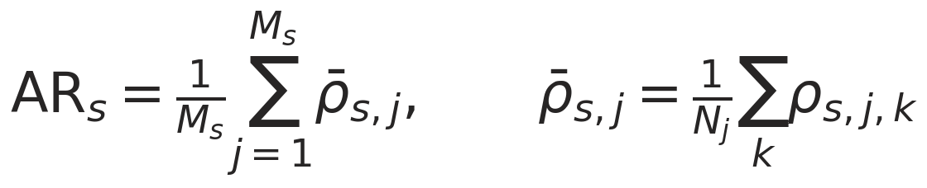
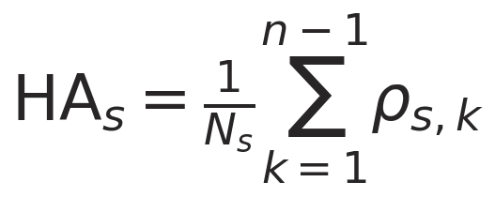
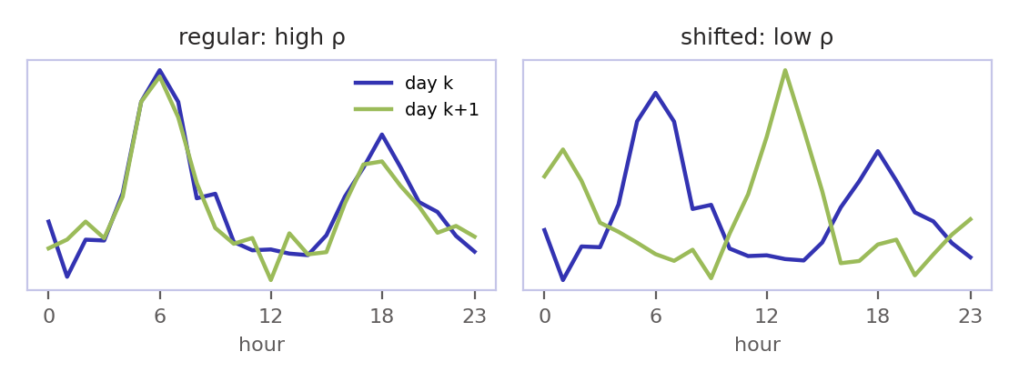
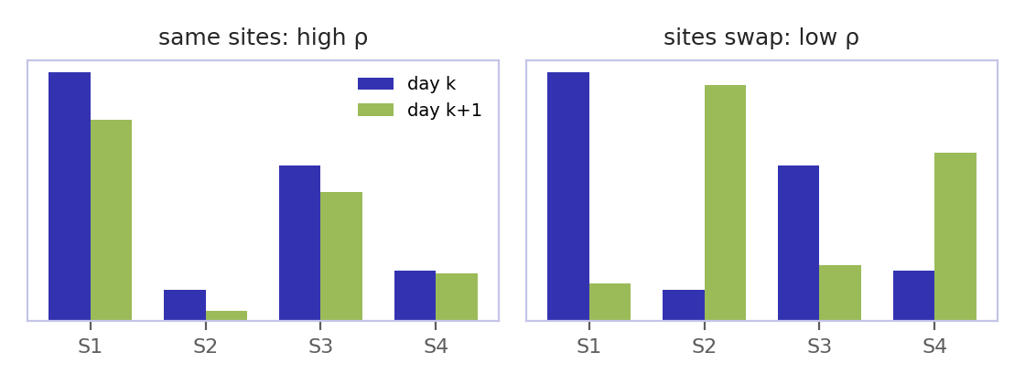
Activity Regularity and Habitat Affinity
1 Record
2 Pre-process
3 Detect
4 Filter
5 Analyse
The same idea twice: correlate consecutive days. AR asks when a bird calls; HA asks where.
Activity Regularity AR
Habitat Affinity HA
Does a species keep the same hourly schedule from one day to the next?
Does a species keep to the same sites from one day to the next?
pairs are used only when both days have at least one detection
pairs are used only when both days vary across sites
Both on the quality-filtered dataset. High values mean stable, predictable behaviour, a signature of resource-rich habitat.

Slide 10
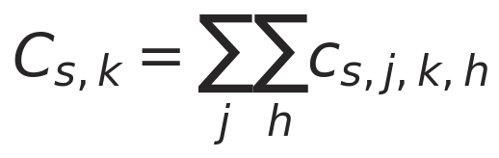
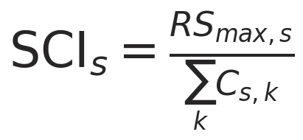
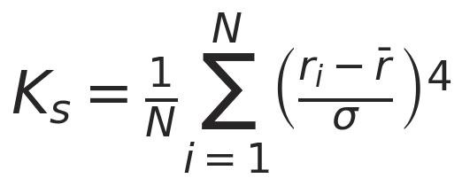
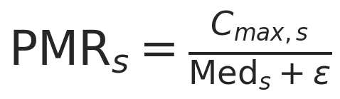
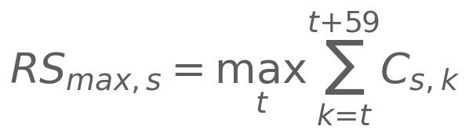
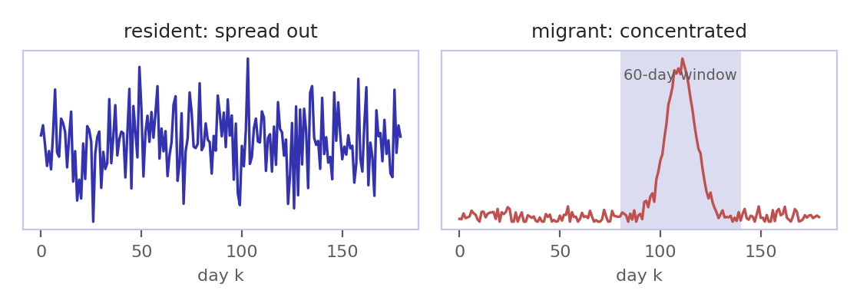
Migratory classification
1 Record
2 Pre-process
3 Detect
4 Filter
5 Analyse
Three complementary views of the daily series
on the temporally filtered dataset.
SCI
Seasonal Concentration Index
K
Residual kurtosis
PMR
Peak-to-Median Ratio
share of all detections inside the busiest 60-day window. Near 1 = migrant-like.
how peaked the residuals are after removing a linear trend. High = a few days of unusual bursts, like an arrival.
the busiest day against a typical day. Large = extreme spikes relative to normal activity.
Decision rule
Thresholds set by inspecting species with known migratory behaviour, so that the criteria separate the two groups cleanly. Everything else is resident.
The silent resident. Coppersmith Barbet scored SCI = 0.97 because it only calls in May. eBird sightings showed it present but silent: a call-to-sighting check is needed before calling anything a migrant.

Slide 11
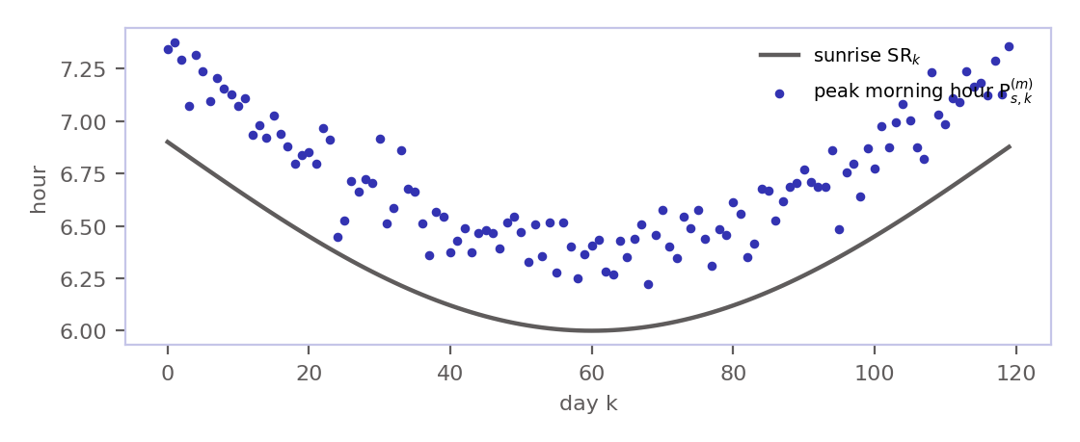
Solar alignment: do birds follow the light?
1 Record
2 Pre-process
3 Detect
4 Filter
5 Analyse
Correlate each day's peak calling hour with that day's sunrise or sunset, on the temporally filtered dataset.
Definitions
Reading the result
Solar events, in decimal hours, from site coordinates (φ, λ):
Peak hour in each window, H_morning = {5…9}, H_evening = {17…20}:
Lags, expected to stay constant if light drives the bird:
High ρ(m) peak morning calling tracks sunrise as it shifts through the season: dawn drives the bird.
High ρ(e) the same for dusk.
Low ρ peak timing is set by something other than light: food, weather, competition.
Correlation over days with a detection in that window:

Slide 12
Limitations and what they imply
Acoustics hears calls, not birds
The confidence floor is permanent
A silent bird is invisible. Seasonal vocal patterns can make residents look migratory; eBird sightings are used as a cross-check.
Detections below the run's threshold are never written. Sites processed at different thresholds have different floors, flagged in the index.
Timestamps come from filenames
Urban noise distorts indices
Date and hour are read from SPOT_YYYYMMDD_HHMMSS names. A file that breaks the convention keeps its detections but loses its place in time.
Traffic hum inflates AEI; rain inflates ADI. Both are handled (NDSI, the rain classifier) but neither correction is perfect.
Season length
Thresholds are chosen, not learned
SCI needs at least 60 days of recordings and the migration rule needs a full season; short deployments can only describe, not classify.
0.3 confidence, 10 detections, 5 days, and the migration τ values were set by inspection against known species, so they may need re-tuning for a new region.

Slide 13
Thank you

